Slide 1
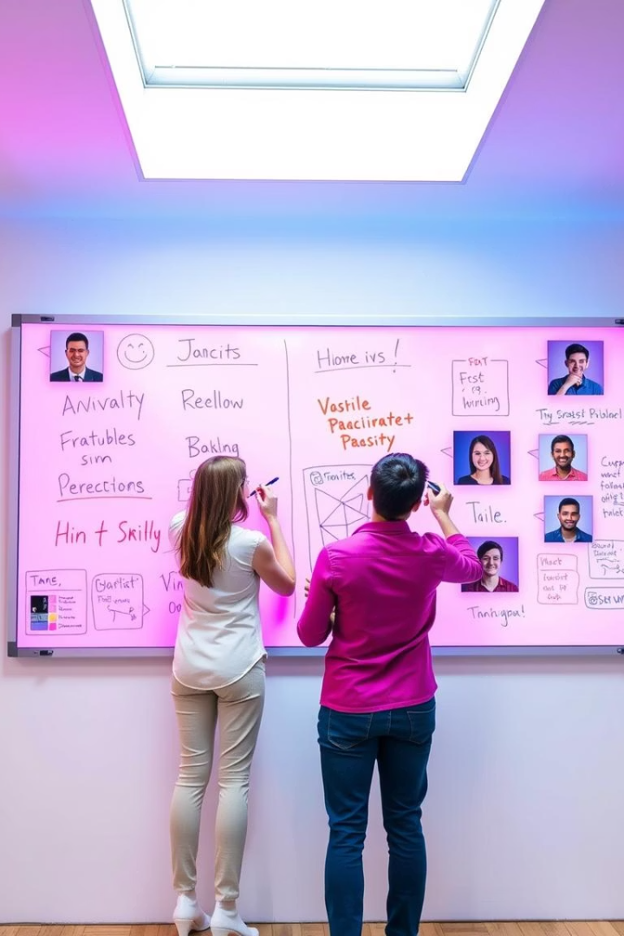
Real-Time Collaborative Whiteboard
A web-based drawing and chat application
enabling instant collaboration.

Slide 2




Introduction to Collaborative Whiteboards
What is a collaborative whiteboard?
Why build one?
Key goals
Enhances remote teamwork and visual communication.
Real-time drawing, room-based collaboration, live chat.
An online space to draw and chat simultaneously.

Slide 3
Architecture Overview
Frontend
Backend
Realtime
Database
React.js for responsive UI and interactivity
Node.js with Express for REST API and server logic
Socket.IO for live communication and data sync
MongoDB stores room and user data efficiently

Slide 4
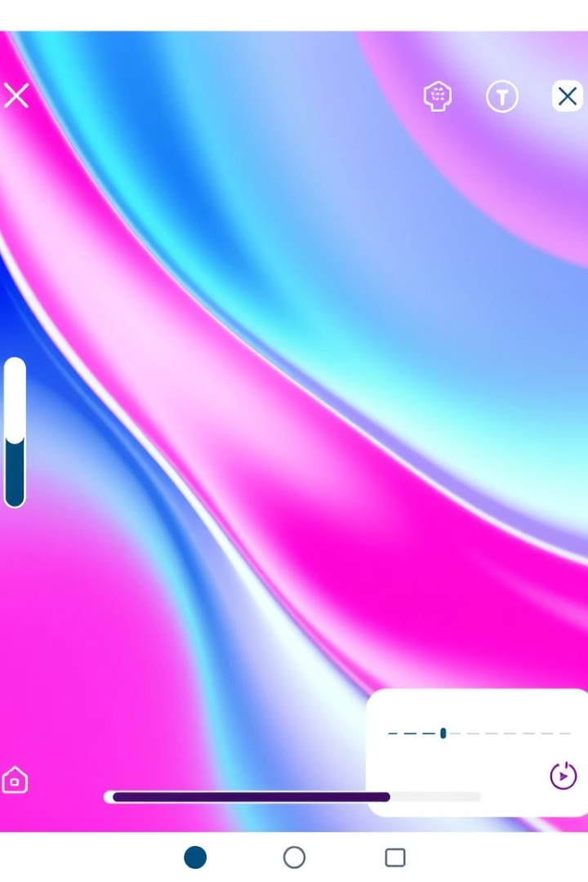
Core Features
Drawing Tools
Room Management
Pen and eraser for flexible input
Create rooms with unique codes
Color picker and brush size adjustment
Clear canvas option per room
Chat Functionality
Live messaging integrated within each room

Slide 5
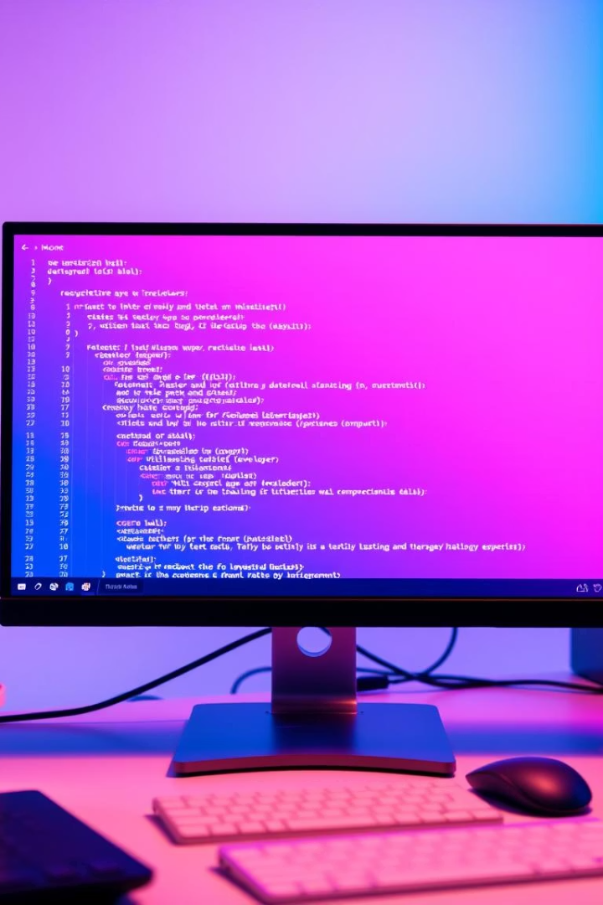



Frontend Using React
Key components
State Management
CreateRoom.js
Using React hooks for synchronous UI updates
Whiteboard.js
ChatBox.js
Socket.IO Client
Handles real-time events and bidirectional communication

Slide 6

Backend With Node.js and Express
Room Management API
Database Schema
MongoDB schema defines room structure and metadata
CRUD endpoints for creating and managing rooms
Modular Design
Controllers and routes separated for maintainability

Slide 7

Socket.IO Real-Time Layer
Events Handled
Room join and leave
Drawing synchronization
Chat messaging broadcast
Canvas clear commands

Slide 8
MongoDB Database Design
Schema Details
Extensibility
Stores room code, creator ID, and timestamps
Easy to add user tracking and other features

Slide 9



Testing & Live Demo
Demo
Edge Case Handling
Shows live drawing and chatting synchronization
Invalid room join attempts managed
Fixes for duplicate room IDs

Slide 10


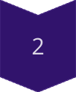
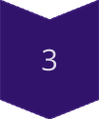
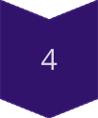
Installation Steps
Clone Repository
git clone ...
Install Client Dependencies
cd client && npm install
Install Server Dependencies
cd server && npm install
Run Application
npm start (for both client and server)
Ensure MongoDB is running before starting the app.

Slide 11

Implementation procedure
1
User 1 (Madhesh) creates a room by clicking the Create button, which generates a unique room code.
2
User 2 (Pablo) joins the room using the unique code generated during room creation.
3
Once both users are in the room, they have access to the shared whiteboard.
4
The whiteboard includes multiple tools such as chat, brush size adjustment, color picker, eraser, and a clear canvas button.

Slide 12

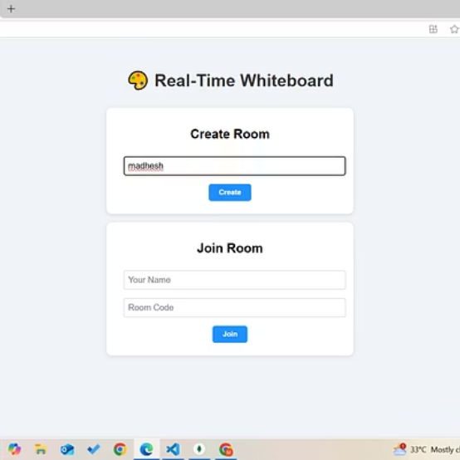
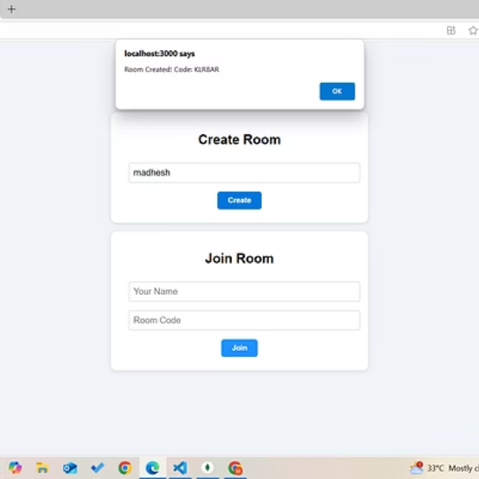
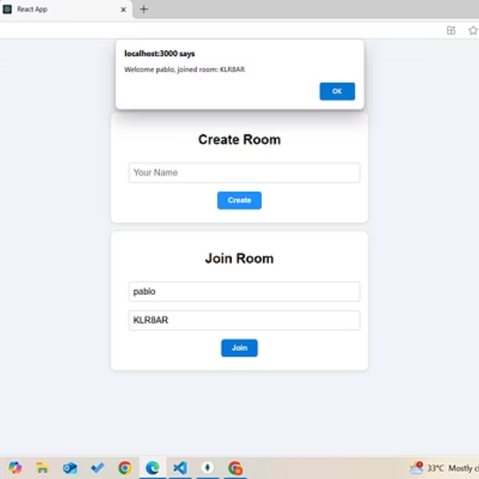
Sample Screenshots Showcase
Explore key features of our collaborative whiteboard through these practical screenshots demonstrating user experience and interface elements.

Slide 13

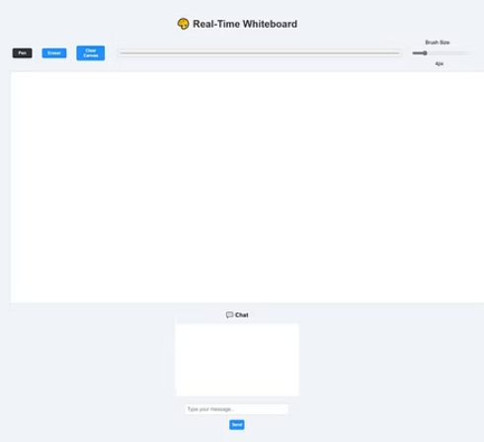
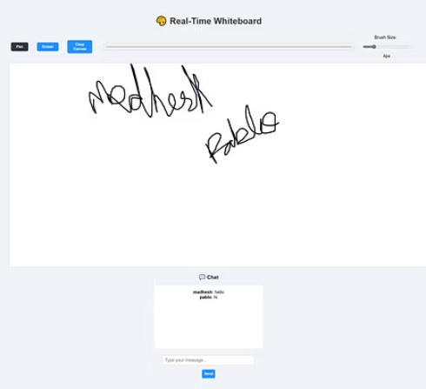
Whiteboard Screenshots
Visual preview of key features and user interactions in our real-time collaborative whiteboard.

Slide 14

Thank You!
We appreciate your time and attention.
If you have any questions or feedback, please feel free to reach out.

